Slide 1
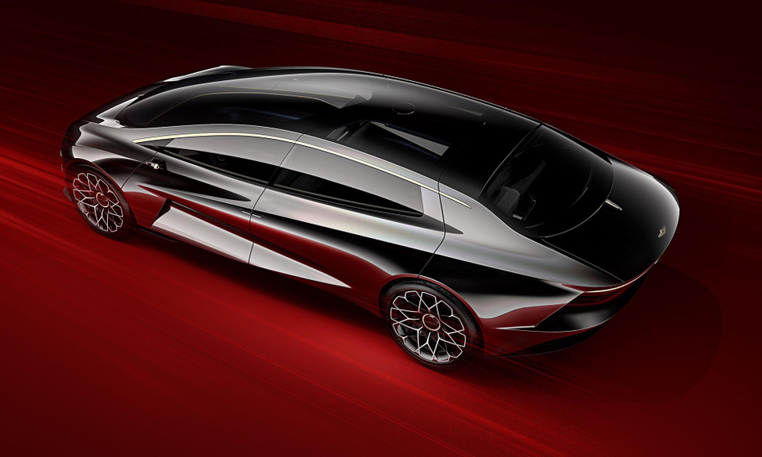
Aston Martin Lagonda
EHSANULLAH AMERKHIL (9826038)
JOSHUA KASSEM (6701448)
NISAR AHMAD AMARKHIL ( 9733367)
WILLIAM AMPAABENG KYEREMEH (9852576)
WORLD’S ONLY INDEPENDENT LUXURY CAR GROUP
Notes:
Good Morning Everyone,
Today we will be presenting our research into the World’s only independent luxury car group, based in the UK.
Before we crack on, let us introduce ourselves.
This is myself Ehsanullah Amerkhil, This is Nisar Ahamd Amarkhil , this is Joshua Kassem and this is William.

Slide 2
Target Market:
United Arab Emirates
Product:
DBX SUV
Price:
AED 848,000
Promotion:
Website, Radio & Television, Magazines & Newspapers, Facebook, YouTube
Place:
Dubai and six other Emirates

Slide 3
CONTENTS
ASTON MARTIN LAGONDA
BUSINESS AUDIT & ANALYSIS
INTERNATIONALISATION
CONCLUSIONS
Overview
Financial performance
Corporate Strategy
Business model
Product Range / Diversification
Target Market – UK and Future
External: Competitive Analysis
Internal: ​Resource Audit
Strengths & Weaknesses
Key Trends and Drivers
Opportunities & Threats
SWOT Analysis
Global readiness
Potential market for expansion
Top two markets
Notes:
Over the next 10 mins or so we will take you through a quick overview of the project, talk about business audit we carried out, how we explored the readiness of Aston martin into international countries and choose one final location before concluding the presentation today.

Slide 4
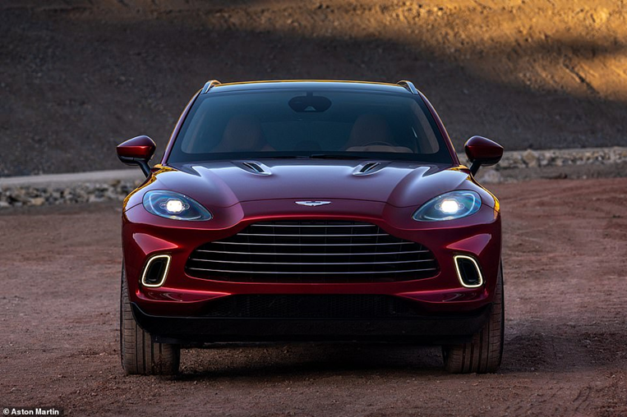
Aston Martin – an overview
Notes:
So starting with the overview of the business

Slide 5
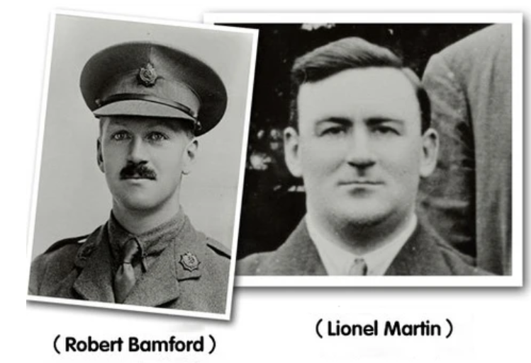
ASTON MARTIN – AN OVERVIEW
Global Designer, Developer, Manufacturer of Luxury Cars.​
Maintaining a legacy of crafting bespoke, high-performance luxury and racing cars ​
107-year history:
In 2018:
Sports car manufactured - 1915
Established in 1913
Incorporated - 2018
85,000 units
95% still in running condition
162 dealers UK
53 countries
200 dealers globally
(Annual Report 2018 & Krishnan, V. V. Lakhani, K. R. & Migdal, A. 2017)​
Notes:
Ashton Martin is – not only a manufacturer by a Global Designer, Developer, Manufacturer of Luxury Cars.
The business was established in 1913 by two English business men – Lionel Martin and Robert Bamford with first car manufactured in 1915.
Over 107-year, Ashton Martin had produced over 85,000 units and 95% of which are still in running condition.
In 2018, the business was incorporated in head quarters in Gaydon. Today, they have 162 dealers across 53 countries and targeting to grow this to 200 dealers globally by end of 2022.

Slide 6

FINANCIAL PERFORMANCE
1,096,500 (2018)
-£57,100
£876,000 (2017)
£76,800
£593,500 (2016)
-£147,600
Sales (£,s) - (year)
Profit (£,s)
Annual Report, 2019
Notes:
From the image below you can see that the business has increased its sales over the years to double, whereas, the profit varies from year to year.

Slide 7
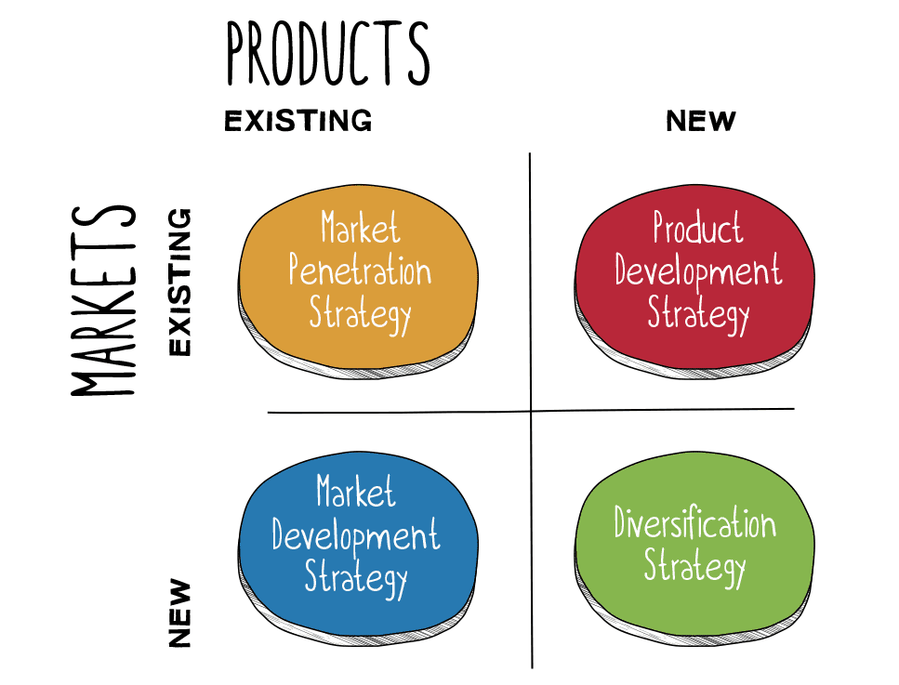


CORPORATE STRATEGY
GLOBAL NICHE MANUFACTURER
TOP CLASS QUALITY
RED BULL – RACING
F1 FORMULA CARS
HIGH NET WORTH INDIVIDUALS (HNWIS)
BRAND OUTLOOK
CUSTOMER FOCUSED LUXURY CARS
REAL ESATE
GRAND TOURISM CHAMPIONSHIP
DIVERSIFICATION
FASHION
Notes:
Aston Martin’s corporate level strategy is simple.
Focus on the selling their brand to High Net Worth Individuals (HNWI). Basically people who can afford to spend…. The core to their target strategy is their desire to sustain the exclusive reputation in luxury car industry – selling products at premium price.
This means:
Delivering customer focused luxury cars
Maximising their revenue by tapping into their brand – which has developed considerable value since 1913.
They want to be known globally for their niche manufacturing – of stylish and classy products including cars.
Deliver top class quality – irrespective of their location.
Diversify their product portfolio – to ensure long term sustainable viability.
Their strategy uses Ansoff matrix to focus on product development strategy and diversification

Slide 8
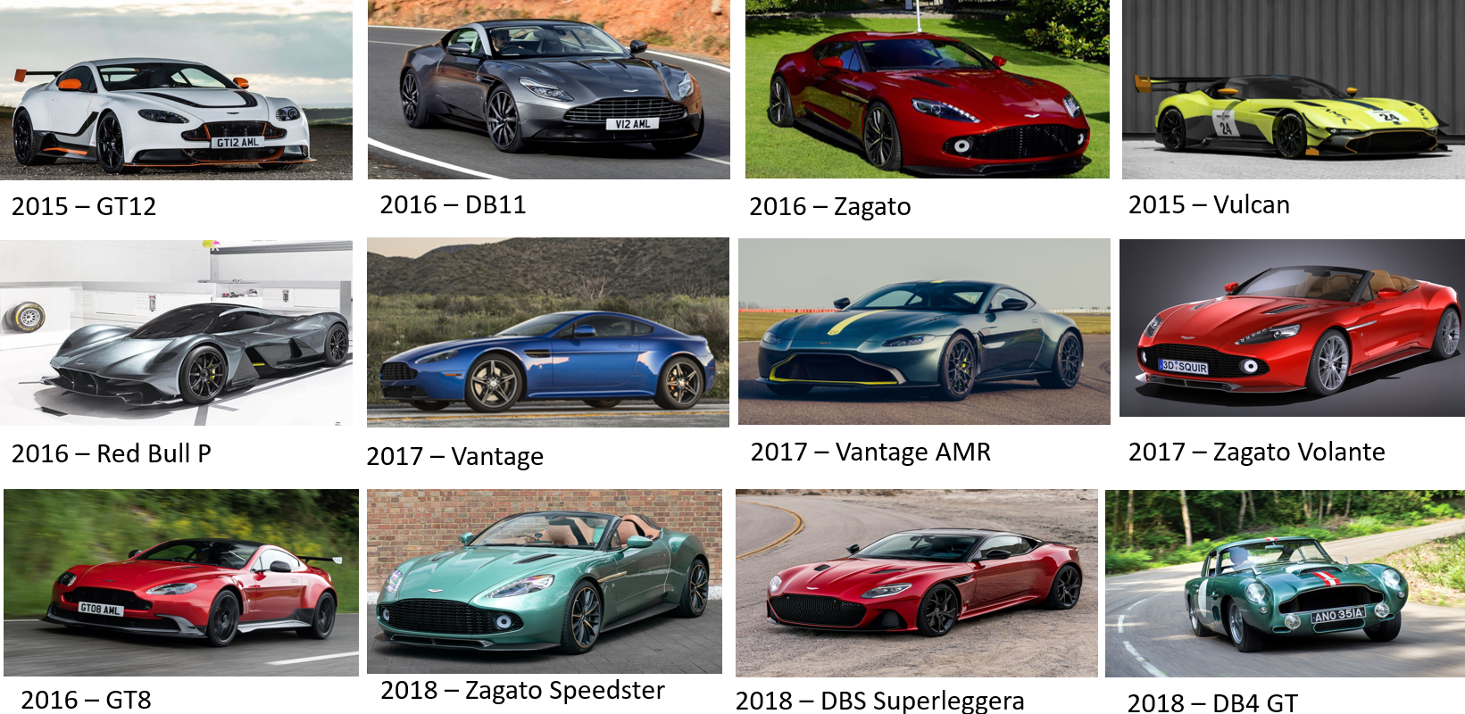
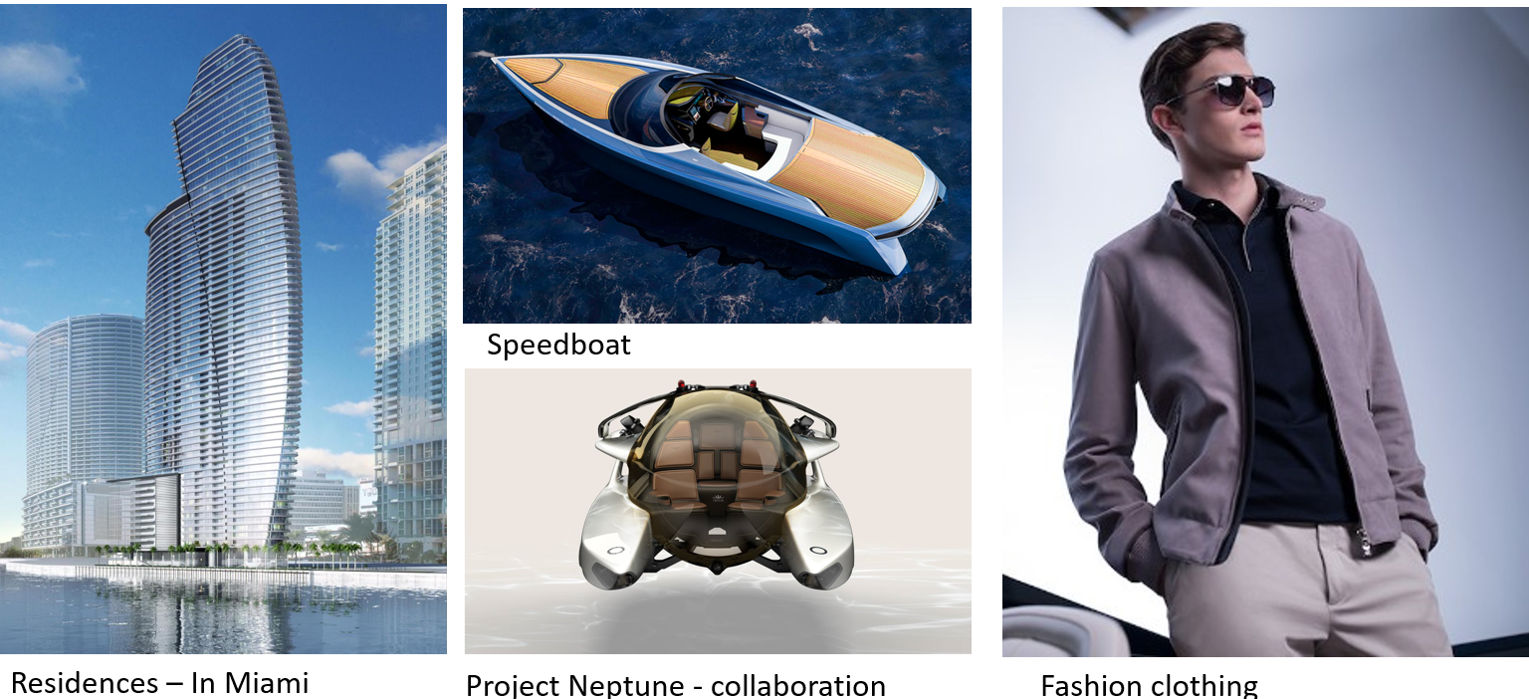
PRODUCT RANGE – OVERVIEW & DIVERSIFICATION

Slide 9
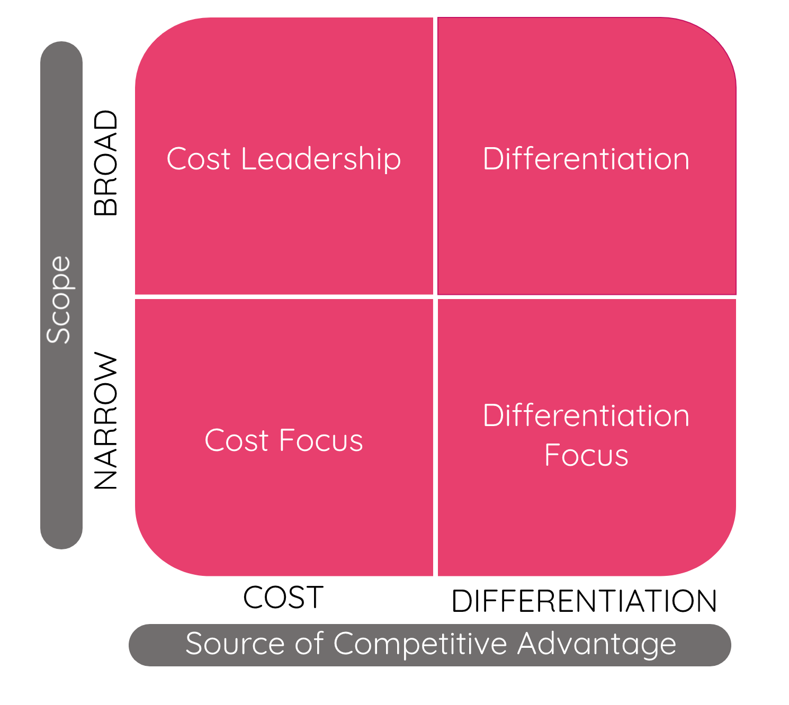
BUSINESS STRATEGY AND MODEL
TO BE THE GREAT BRITISH CAR COMPANY THAT CREATES THE MOST BEAUTIFUL AND ACCOMPLISHED AUTOMOTIVE ART IN THE WORLD.
VISION
SECOND CENTURY PLAN
PHASE 1
+
PHASE 2
+
PHASE 3
INSPIRING CUSTOMER FOCUSED LUXURY PRODUCTS
STRENGTHENED GLOBAL BRAND AND SALES POWER
WORLD-CLASS VALUE AND LEAN PROCESSES
TOP-CLASS QUALITY
PASSIONATE PEOPLE AND CULTURE AND CORPORATE RESPONSIBILITY
CLEAR LONG-TERM FINANCIAL FRAMEWORK
CORE:
GT, sports and mid-engine (4 models)
SUVs (2 models)
Sedans (1 model)
DELIVERING 7x7x7
SPECIAL:
2 specials, on average, per annum
One heritage special, on average, per annuum
Notes:
Aston Martin is following differentiation focus strategy in line with Porter’s competitive model.
They have a 3 phase business model – with each phase with a 7 year life cycle. Since 2015, the secret behind their success is based on following a strategic plan consisting of 6 core pillars.
• Inspiring customer-focused luxury products
• Strengthened global brand and sales power
• World-class value and lean processes
• Top-class quality
• Passionate people and culture and corporate responsibility
• Clear long-term financial framework
Their product portfolio is comprising of core products and special items.

Slide 10

TOP NOTCH-TECHNOLOGY
Power: 4 liters twin turbo V8 with 550hp 700Nm Torque
Speed: 0-60mph in 4 .5 seconds with top speed at 181mph
No terrain barrier: 6 adaptive driving modes (4 on road and 2 off road), can go as high as 45mm off the road
Towing Capacity – 5490 pounds
Capacity: 19.4 miles per gallon
Output: 269g/km carbon output
4
6
5
1
2
3
Notes:
Their biggest target is to deliver a products with top notch technology…. For example their DBX model which you see on the screen is powerful, fast has no terrain barriers, fantastic towing capacity and offers performance to their clients.

Slide 11
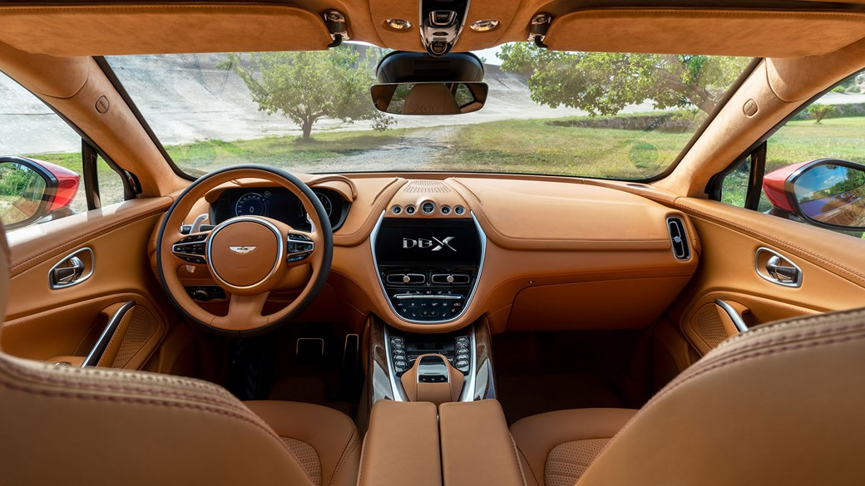
BUSINESS MODEL : EXQUISITE DESIGN
Family friendly
Classy Interiors
Family friendly
Spacious
Female Friendly
Custom made
Brand New Structure
6
1
5
2
3
4
Notes:
What makes DBX stand out is it’s exquisite design…..
Classy, family friendly, spacious, suitable for HNW women. It’s custom made and it comes with a exclusive brand new structure….

Slide 12


TARGET MARKET – HOME (UK) & INTERNATIONAL
MEN AND WOMEN
TRADES
INCOME - £175,000
ULTRA HIGH NET WORTH
MID-THIRTIES & OLDER
F1 SPORTS MEN
OWN HOUSE
SELF-EMPLOYED
AROUND 30% WITH 4-YEAR COLLEGE
(Gilmore, G 2015, Krishnan, V. V. Lakhani, K. R. & Migdal, A. 2017)
Notes:
Aston martin’s target market is Ultra-high net worth individuals in their mid-thirties to 65 who are financially independent with spare cash to enjoy their products. That means anyone with annual average income of £175,000.

Slide 13


TARGET MARKET – HOME / UK & INTERNATIONAL
United Kingdom (Home Market)
International Market
Wholesale volumes – 1798 (28% share)
Revenue: £307.02M
Operating Profit: £20.44M
Adjusted EBITDA: £69.16M
Number of dealers: 21
Location: Asia Pacific, EMEA & America
Wholesale volumes – 4643 (72% share)
Revenue: £789.48M
Operating Profit: £52.56M
Adjusted EBITDA: £177.84M
Number of dealers: 141
(Gilmore, G 2015, Krishnan, V. V. Lakhani, K. R. & Migdal, A. 2017)
(2018 Annual Report)
Notes:
Over 2018, 28% of Aston Martin’s sales have been secured through UK market whereas 72% is from Asia, EMEA and America…. This is approximately 790M per annum. This clearly shows how the business is ready to explore and invest into another international country….
Now over to Nisar to talk about External and Internal analysis.

Slide 14
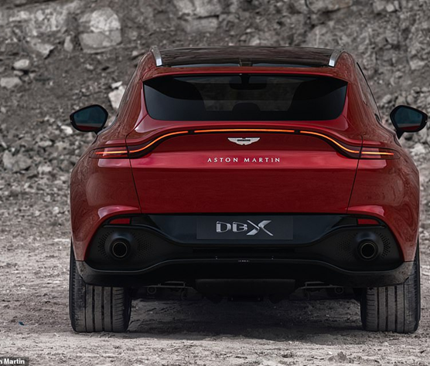
Business Audit & Analysis

Slide 15
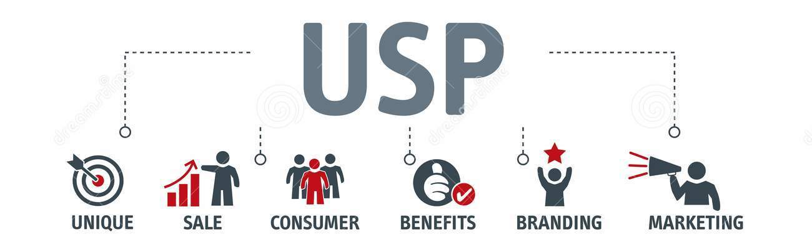


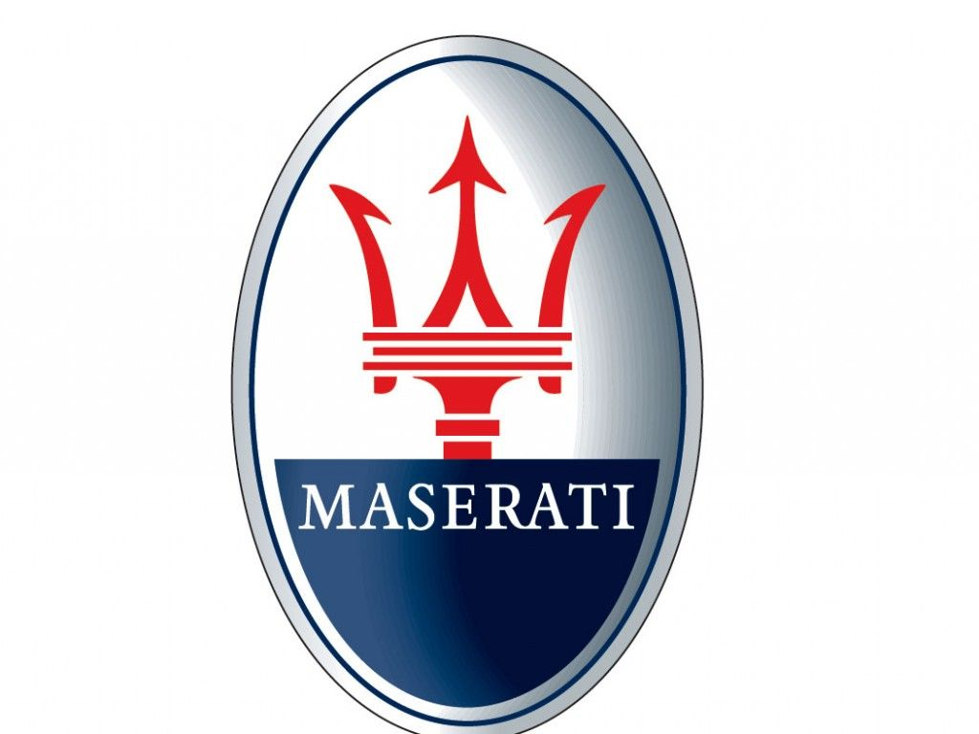
USP
LUXURY VEHICLES
UPPER CLASS
STATUS
EXCLUSIVITY
SUPERIOR
POWER
Notes:
positioned themselves in the luxury vehicle market with emphasis on power, class and status.
Their largest competition includes Mercedes Benz AMG, Porsche, Bentley, Maserati and Jaguar.
These car brands serve an affluent, upper class market.
The need of this market is a luxury vehicle that signifies status and class, matched with a powerful engine and exclusivity that makes the consumer feel superior.
sponsorship of the popular 007 movie series

Slide 16
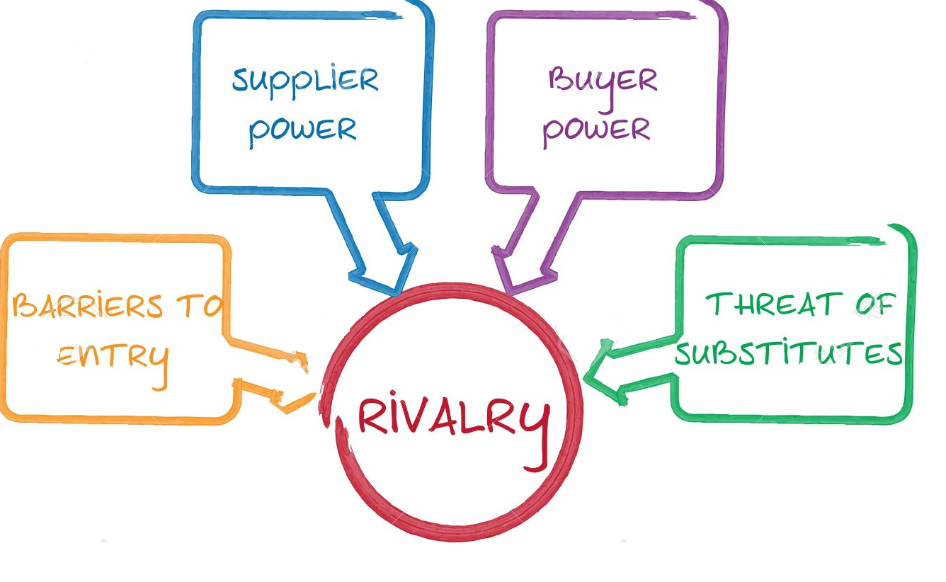
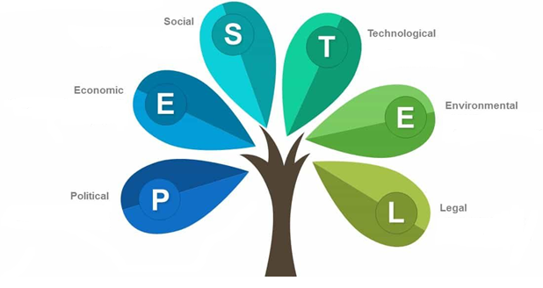
EXTERNAL ANALYSIS (FACTORS)
2. INTELLECTUAL PROPERTY
1. ADVANCING TECHNOLOGY
Risk involved with steal of intellectual property.
Replica of products by competitors.
3. REPLICA PRODUCTS BY COMPETITORS
Hybrid or electric car
Network Connectivity Features
Autonomous driving
EXTERNAL FACTORS
90-acre factory in St. Athan for manufacturing
5. SUPPLY CHAIN ISSUES
4. TECHNOLOGY ADVANCEMENT
Failing to meet trend of electric and hybrid cars
Due to political decisions – such as Brexit
Notes:
Assessed the external factors ..
Summarise this…. below
Trends and
​Switching to electric cars by considering carbon emission
Connectivity of technology
New trend of hybrid and electric cars is emerging.
Competitors in luxury automobile industry are switching to mid engine automobiles
Manufacturing has suﬀered due to political decisions such as Brexit and US-China Trade War
Risks involved with steal of intellectual property like Chinese low priced similar designed cars (Batmunkh et al., 2017)
Autonomous Driving
Competitive environmental analysis
Medium due to high manufacturing investments required to develop luxury products, but Chinese alternatives like LandWind X7, meanwhile, is a mirror image of the Range Rover Evoque SUV
High risk involved due to key trend of electric and hybrid automobiles like TESLA Model X
High disruption risks involved with supply chain due to the US China trade war with increased tariffs on steel and aluminum (Batmukh et al., 2017)
low risks involved due to specific market segment prefer to buy the luxury cars
High competitive rivalry due to advancing technologies and cost leadership strategies adopted by rivals like BMW, AUDI, BENTLEY, and JAGUAR (Quang, 2017)

Slide 17
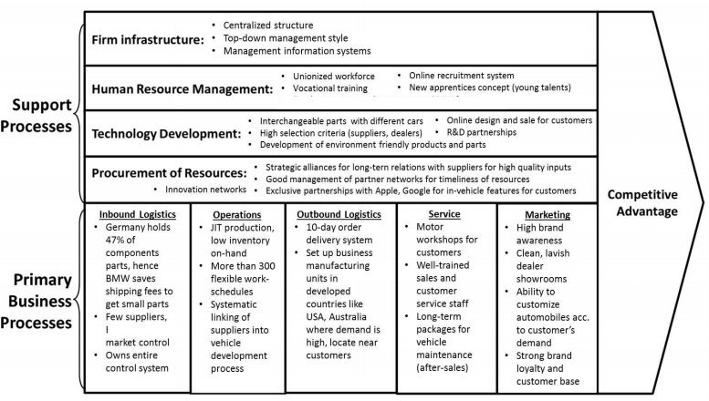
Value Chain Analysis
Notes:
We then used the value chain analysis to evaluate the …

Slide 18
INTERNAL FACTORS
1. INTANGIBLE RESOURCES
2. FINANCIAL RESOURCES
Adjusted operating profit – £146.9M (18% increase in 2018)
Revenue – £1.096bn (25% increase in 2018)
(Aston Martin Press Release, 2020)
£298M in 2018 (20% of intangible assets) + deferred development costs – over £1bn (68% of total)
(The Motley Fool, 2019)
3. PHYSICAL RESOURCES
INTERNAL FACTORS
5. OTHER RESOURCES
90-acre factory in St. Athan for manufacturing
4. HUMAN RESOURCES
2500 workforce – UK technical skilled labour
(Guardian, 2019)
Unique customer base – luxury products
(Aston Martin Financial Report, 2017)
Notes:
Internal business factors…
Summarise below
Intangible Resources: Aston Martin valued its brands at £298m in 2018, representing 20 per cent of its intangible assets – however, the biggest intangible was deferred development costs of just over £1bn or 68 per cent of the total (The Motley Fool, 2019)
2. Financial Resources: The adjusted operating profit rose 18% in 2018, to 146.9 million British pounds ($195.4 million). Revenue rose 25% from the company's 2017 result, to 1.096 billion pounds ($1.46 billion) (Aston Martin Press Release, 2020)
3. Physical Resources: opened its new 90-acre factory in St. Athan for the production of its first-ever SUV the DBX, and two new models under the Lagonda marque
4. Human Resources: Total workforce of 2500 employees in the UK represents a technical skilled labour force for manufacturing company (Guardian, 2019)
5. Other Resources: Unique customer base due to luxury products with high brand value (Aston Martin Financial Report, 2017)

Slide 19
SWOT
Strong financial performance and sales (2018)
Brand Image Value - £298M (2018)
Unique bonded aluminum body design
​Mid- engine portfolio
90 acre factory / production facility in St. Anthem
Ability to control medium-term investment, improving cash generation and reshaping product cadence
Limited range of models / choice for customers
Delayed investment in electric vehicles (past 2025)
High increasing tariﬀs on steel and aluminium 25% - disrupting manufacturing
(Guardian, 2019)
(Quang, 2017)
STRENGTH
WEAKNESSES
OPPORTUNITIES
THREATS
Failing to adopt hybrid & electric cars,
stringent zero-emissions standards
Autonomous driving capabilities
Increase in competition such as car-sharing services (e.g. Uber)
Brexit - Trade difficulty
Disrupted supply chain network (political)
Lack of human resources
Steal of intellectual propesrty (IP)
Growing Number of UHNWIs
Formula 1 partnership / sports & racing products and team
HNW women and younger millionaires
Free Trade Zone allowing 100% foreign ownership
Adopting digital marketing & communication
Adopting sustainable strategies
Switching to hybrid and electrical automobiles
Guo et al., 2017;
The Motley Fool, 2019, Aston Martin Financial Report, 2017
Notes:
Strength
Brand prestige capture the company’s long-running association with the James Bond movie franchise
Unique bonded aluminum body structure
Providing greater financial and operational stability and flexibility through controlling medium-term investment, improving cash generation and reshaping product cadence​
mid- engine portfolio remains a key focus for the Company starting with Valhalla in 2022​
Weakness
Limited range of model reduce customers choice
Investment in electric vehicles will be delayed beyond 2025​
Disruption in manufacturing expected due to high increasing tariﬀs on steel and aluminium 25%
Political tensions in regions like Middle East and South China Sea can disrupt the whole supply chain (Guo et al., 2017)
Opportunities
Not only build sport cars but racing team to
Use the Formula 1 partnership to widen it range of products
Focus on high net worth women and younger millionaires
Threats:
Hybrid and electric engines
Stringent zero-emission vehicles (0EV) standards
Autonomous driving capabilities
Network-connected features
Rise in car-sharing services like Uber
Brexit could result to trade difficulty
TREAT
Hybrid and electric engines
Stringent zero-emission vehicles (0EV) standards
Autonomous driving capabilities
Network-connected features
Rise in car-sharing services like Uber
New Market Penetration:
Explore wider target market with the DBX SUV
Not only build sport cars but racing team to
Use the Fomula 1 parternship to widen it range of products
Focus on high net worth women and yonger

Slide 20
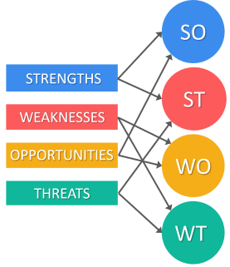
SWOT DRIVEN STRATEGIC ACTION
Upcoming Bond ﬁlm, No Time To Die featuring four models: the classic DB5 and V8 Saloon, as well as DBS Superleggera and Valhalla (The Motley Fool, 2019, Aston Martin Financial Report, 2017) – boosting sales.
​DBX to compete with Porsche Cayenne and Macan, the Bentley Bentayga, and the Lamborghini Urus.
Palmer’s campaign to win over buyers and regain investor conﬁdence.
All-electric sports sedan - push to more than double annual sales. Targeting over 7,500 vehicles, from 3,500 last year.
Electriﬁcation strategy part of a “reset plan" - will cause job cuts and a restructuring of sales and marketing operations.
Notes:
​
WT Strategy: electriﬁcation strategy is part of a “reset plan" that will also see unspeciﬁed job cuts and a restructuring of sales and marketing operations.
WO Strategy: The all-electric sports sedan is part of the brand’s push to more than double annual sales to above a former peak of about 7,500 vehicles, from 3,500 last year
ST Strategy: DBX will be the biggest step yet in Palmer’s campaign to win over buyers and regain investor conﬁdence in the Gaydon, England-based automaker. The DBX will compete with the Porsche Cayenne and Macan, the Bentley Bentayga, and the Lamborghini Urus.
SO Strategy: They are hoping the upcoming Bond ﬁlm, No Time To Die, will help boost sales as it feature four of its models: the classic DB5 and V8 Saloon, as well as the new DBS Super leggera and Valhalla (The Motley Fool, 2019, Aston Martin Financial Report, 2017)

Slide 21
Internationalisation

Slide 22
GLOBAL READINESS
> 5 years of international experience + score of 75%
In 2018, 28% of Aston Martin’s sales secured through UK market
72% is from Asia, EMEA and America. (Approx. £790M per annum.)
Aston Martin is Ready to explore, enter and invest into another international country.
Notes:
In 2018, 28% of Aston Martin’s sales where from the UK
78 % where from Asia, Middle east & America which Account for Approx. £790m
And with over 5years international experience
Aston Martin has the potential to explore the international market with it DBX SUV

Slide 23
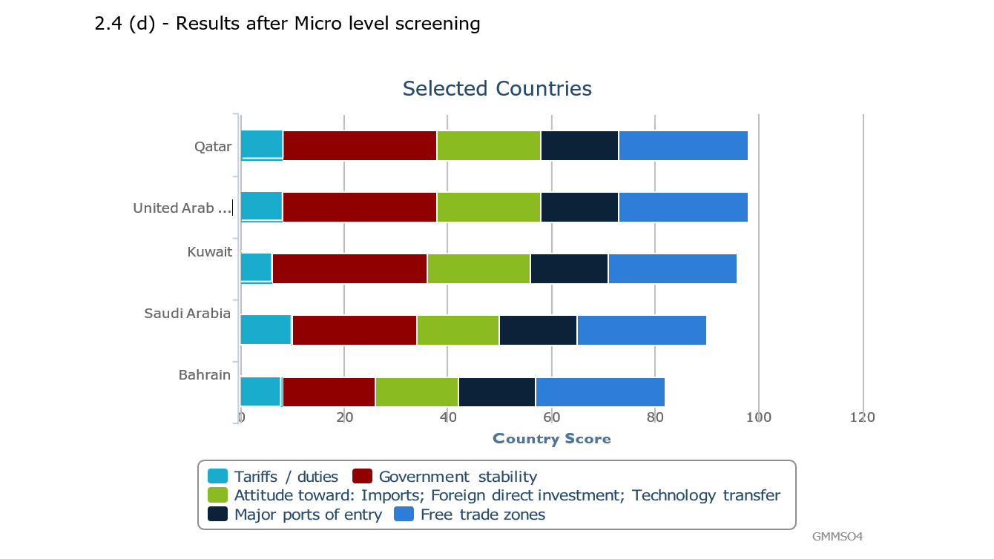
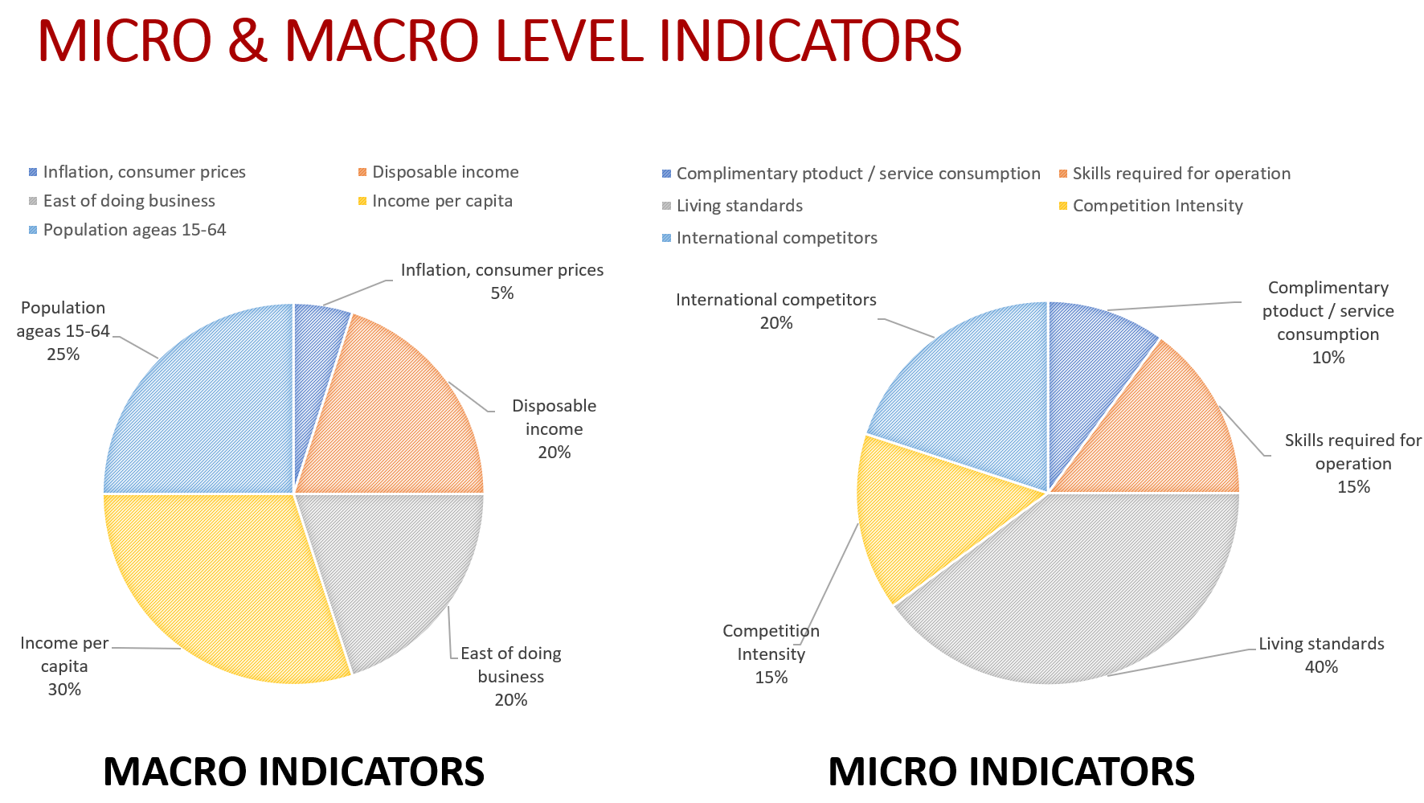
POTENTIAL MARKET FOR EXPANSION
Notes:
To arrive at the country with the highest market potential for our product,
We use Macro Level criteria and Micro level indicators to arrived at:
The top 5 potential markets of:
i. Qatar
ii. United Arab Emirates
iii. Kuwait
iv. Saudi Arabia and
v. Bahrain
Which were selected based on the following criteria
Government stability
Free trade zones
Tariffs/duties
Country’s attitude towards imports, FDI

Slide 24
POTENTIAL MARKET FOR EXPANSION
2. MAJOR PORTS OF ENTRY
3. ATTITUDE TOWARDS: IMPORTS; FDI; TECHNOLOGY TRANSFER
1. GOVERNMENT STABILITY
4. FREE TRADE ZONES
Tax System
Business Environments
Import / Export Duties
Customs Duty Deferral
Military situation
Quotas-based tariffs
Duty payments
Notes:
Government stability:
Consistent tax system with minimal changes
Secure business environments without riots
Less chances of military coups/political riots
Attitude toward: Imports; Foreign direct investment; Technology transfer
Major ports of entry
Free trade zones
Elimination of Import/Export Duties
Customs Duty Deferral
Lower quota-based tariffs
Lower duty payments

Slide 25


TOP TWO MARKETS
Bahrain
United Arab Emirates
No existing trade agreement with the UK
GDP per capita - $24,050.76 (World Bank, 2020)
100% foreign-ownership without local partner
No tax on corporate & personal income, wealth, capital gains, withholding, or death/inheritance
No restrictions on repatriation of capital, profits or dividends
Bilateral agreement with the UK
GDP per capita - $43,004.95 (World Bank, 2020)
No restrictions on foreign ownership
Tax-free environment
Strong Banking System
Stable Political System
Free Trade Zones
Proximity to other Gulf markets
Jebel Ali Free Trade Zone (JAFZA) is the world’s largest .
Source: UAE-UK Business Council (2019)
Notes:
With the aid of software, Our top two markets are
United Arab Emirates
Bahrain
They both have good merits
The United Arab Emirates?
Bilateral agreement with the UK
GDP per capita of $43,004.95 (World Bank, 2020).
No restrictions on foreign ownership
A tax-free environment
a strong banking system
a stable political system
Free trade zones that allow 100% foreign ownership
Proximity to other Gulf markets which will serve as an entry route to other GCC countries
Jebel Ali Free Trade Zone (JAFZA) is the world’s largest .
UAE-UK Business Council (2019)
Why Bahrain?
Permit 100% foreign-ownership of a business or branch office, without the need for a local partner
Bahrain has no tax on corporate income, personal income, wealth, capital gains, withholding, or death/inheritance.
Bahrain has no restrictions on repatriation of capital, profits or dividends.

Slide 26

TOP TWO MARKETS
Bahrain
United Arab Emirates
The number of HNWIs in Bahrain stood at 5,400, far lower than UAE
Real GDP growth rates have slowed down.
Over 78,153 HNWI
Notes:
Why UAE (yes) – explain graph
Why not Bahrain?
The UK does not have a trade agreement with Bahrain
The number of HNWIs in Bahrain stood at 5,400, far lower than UAE
GDP Per Capita $24,050.76 (World Bank, 2020)
Real GDP growth rates have slowed down.

Slide 27
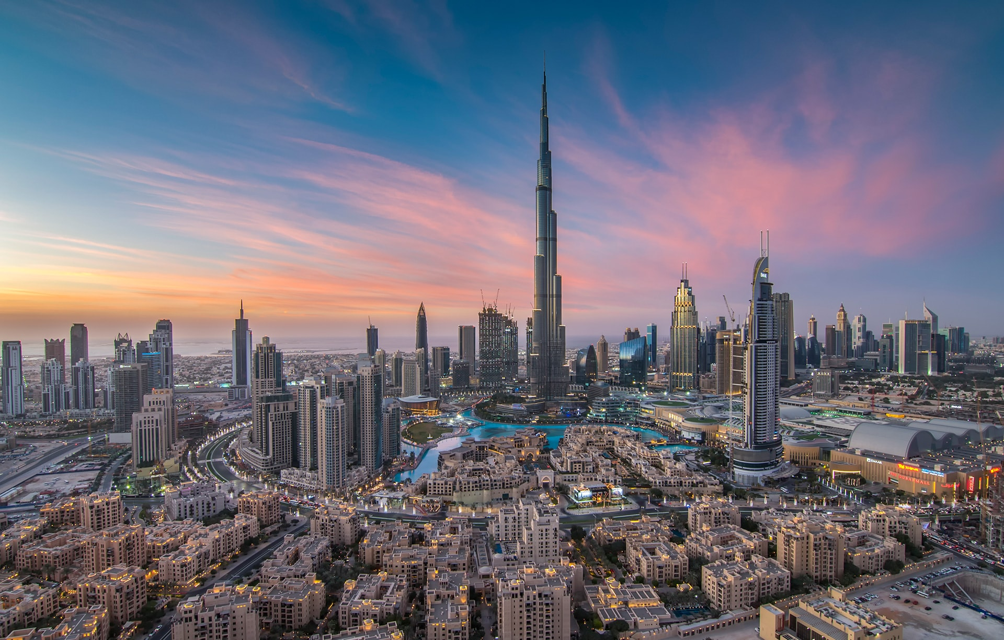

Slide 28
Conclusion

Slide 29
CONCLUSIONS
Strong financial performance (2018)
Corporate strategy – focus on HNWIs and maximise brand value
Business strategy – 7x7x7 with core and special products including diversified markets
28% revenue and sales from Uk market + 72% from international
Standing strong in international market against its competitors –Jaguar, Mercedes Benz, Ferrari, Maserati, Bentley etc.
Internal audit of the business through - Macro and Micro level analysis and SWOT analysis of the business and the product (DBX) – all positive
United Arab Emirates and Bahrain were identified as two potential top markets and evaluated against 5 criteria
United Arab Emirates – was chosen as best potential country to launch DBX – rapidly growing number of HNWIs, with large disposable income. Therfore ideal market to leverage Aston Martin’s brand image.
Best point of entry into UAE is – Direct export and sales into the market.

Slide 30
Bibliography
Aston Martin Press Release (2020). Aston Martin Lagonda Global Holdings plc , Available at: https://amlcorp.blob.core.windows.net/default-storage/docs/default-source/documents/results-centre/2020---results-centre/equity-investment-and-right-issue/equity-investment-and-rights-issue---press-release.pdf?sfvrsn=301a3ffe_4 [Retrieved on: 25th, Feb, 2020]
Aston Martin Financial Report (2017). Aston Martin Holdings UK Plc, Available at: https://amlcorp.blob.core.windows.net/default-storage/docs/default-source/documents/bondholders/financial-releases-and-presentations/2016/aston-martin-holdings-(uk)-limited-2016-annual-report-amp-financial-statements.pdf?sfvrsn=b4e5283c_4 [Retrieved on: 25th, Feb, 2020]
The Motley Fool (2019). Aston Martin Lagonda's Profit Grew in 2018, but Brexit Looms Over 2019, Available at: https://www.fool.com/investing/2019/03/04/aston-martin-lagondas-profit-grew-in-2018-but-brex.aspx Retrieved on: 25th, Feb, 2020]
Guardian (2019). Aston Martin opens new factory in south Wales to build SUV, Available at:
https://www.theguardian.com/business/2019/jun/10/aston-martin-targets-wealthy-women-first-suv-dbx Retrieved on: 25th, Feb, 2020]
Ozuem, W. (2017). Digital marketing. In Essentials of Marketing Management (pp. 298-307). Routledge. Krishnan, V. V., Lakhani, K. R., & Migdal, A. (2017). Aston Martin: A Second Century of Performance and Luxury.
Zhikang, L. (2017). Research on development strategy of automobile reverse logistics based on SWOT analysis. Procedia engineering, 174, 324-330
Guo, G. C., Jiang, C. X., & Yang, Q. (2017). The Effect of Government Involvement on Chinese Firms' Corporate Entrepreneurial Activities: The Case of Chinese Automobile Industry. New England Journal of Entrepreneurship, 20(1), 1.
Do Quang, H. (2017). Marketing SWOT Analysis of Rolls-Royce Motor Cars (Doctoral dissertation, Empire State College).
Batmunkh, U., Barnes, R., Barbosa, E., Kaya, Z. D., & Samuda, C. (2017). The Future of the UK Midlands Automotive Cluster.
iNews (2019). Aston Martin expects a James Bond boost from No Time To Die to reverse decline in sales, Available at: https://inews.co.uk/news/business/aston-martin-james-bond-boost-new-film-no-time-to-die-sales-919477 Retrieved on: 25th, Feb, 2020]

Slide 31
Bibliography
Ozuem, W. (2017). Digital marketing. In Essentials of Marketing Management (pp. 298-307).Routledge. Krishnan, V. V., Lakhani, K. R., & Migdal, A. (2017). Aston Martin: A Second Century of Performance and Luxury.
Zhikang, L. (2017). Research on development strategy of automobile reverse logistics based on SWOT analysis. Procediaengineering, 174, 324-330
Guo, G. C., Jiang, C. X., & Yang, Q. (2017). The Effect of Government Involvement on Chinese Firms' Corporate Entrepreneurial Activities: The Case of Chinese Automobile Industry. New England Journal of Entrepreneurship, 20(1), 1.
Do Quang, H. (2017). Marketing SWOT Analysis of Rolls-Royce Motor Cars (Doctoral dissertation, Empire State College).
Krishnan, V. V. Lakhani, K. R. & Migdal, A (2017) ‘Aston Martin: A Second Century of Performance and Luxury’ Harvard Business School Case 617-033,
Batmunkh, U., Barnes, R., Barbosa, E.,Kaya, Z. D., & Samuda, C. (2017). The Future of the UK Midlands Automotive Cluster.
iNews(2019). Aston Martin expects a James Bond boost from No Time To Die to reverse decline in sales, Available at: https://inews.co.uk/news/business/aston-martin-james-bond-boost-new-film-no-time-to-die-sales-919477Retrieved on: 25th, Feb,2020]
¨
Reuters (2020) ‘Aston Martin Lagonda Global Holdings PLC’
https://www.reuters.com/companies/AML.L/financials

